Slide 1
BDS – Basic Data Structure
Anagha Bhatkhande Varsha Mahajan
V 1.0
Effective date: 01-Nov-2017
Copyright © 2016 Tata Consultancy Services Limited
Notes:
Title Slide
Theme Image area
We need to place appropriate image based on the content of the Presentation
Version No
Release date
PALS logo
TCS logo
Theme 1-a
Align text to the bottom of the logo bottom line
Font size 10pt

Slide 2


Confidentiality Statement
This document contains information which is commercially confidential to Tata Consultancy Services Ltd. ("TCS") and is provided for the sole purpose of permitting the recipient to evaluate the proposal submitted within the document. In consideration of the receipt of this document, the recipient agrees to maintain the information it contains in confidence and not to reproduce or otherwise disclose the contents of this document to any person outside the recipient's evaluation team or nominated advisors. The document may not be used, reproduced or disclosed to others, except as specifically permitted by TCS in writing. The recipient of this document, by its retention and use, agrees to take reasonable endeavours to protect the document and the information it contains from loss or theft.
© 2017 - TATA Consultancy Services Limited (TCS)
TCS confidential

Slide 3
BDS : Basic Data structure
BDS dataset contains one or more records per subject, per analysis parameter, per analysis timepoint (only if present)
Classification of variables in the BDS datasets
Subject Identifier variables
Treatment variables
Timing variables
Analysis Parameter variables
Analysis Descriptor variables
Indicator variables
Data point traceability variables
Analysis-Enabling variables
TCS confidential
Notes:
Analysis Visit Windowing variables
Time to Event variables
Toxicity and Range variables

Slide 4
Relation between ADaM BDS and Mock up tables
Statistical Analysis Plan (SAP)
Mock shells for Tables, Listings and Figures
Annotation of Mock shells
Specifications (Metadata) for SDTM and ADaM
Process Flow
SDTM
ADaM
TLF
TCS confidential
Notes:
For pooling of legacy studies when ADaM is directly generated from the shells

Slide 5
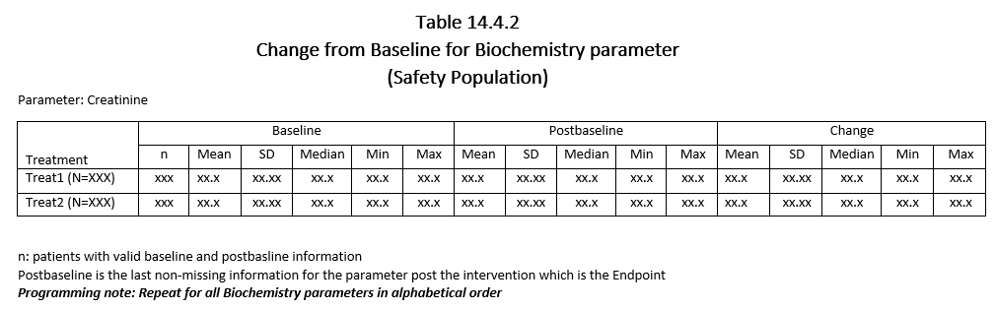
Example Mock shell
Following variables will be needed to create this output:
Population variable – SAFFL
Laboratory Parameter – PARAMCD, PARAM
Treatment variable – TRTAN, TRTA
Baseline information – BASE
Change information – CHG
Postbaseline – AVAL and AVISIT
TCS confidential
Notes:
Stat responsibility

Slide 6
Annotated Mock Shell
ADSL.SAFFL=‘Y’
ADLB.PARMCD=‘CREA’
ADLB.AVAL Where ADLB.AVISIT=‘ENDPOINT’
ADLB.CHG
ADSL.TRTAN
ADLB.BASE
TCS confidential
Notes:
Stat and lead programmer responsible for annotation

Slide 7
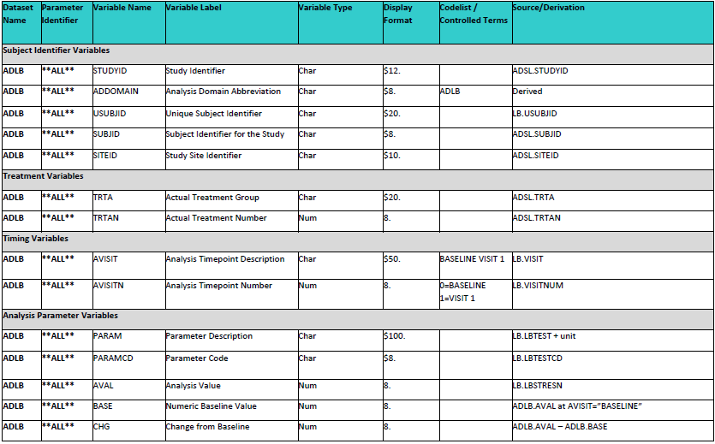
ADLB – BDS Structure
New columns added
TCS confidential

Slide 8
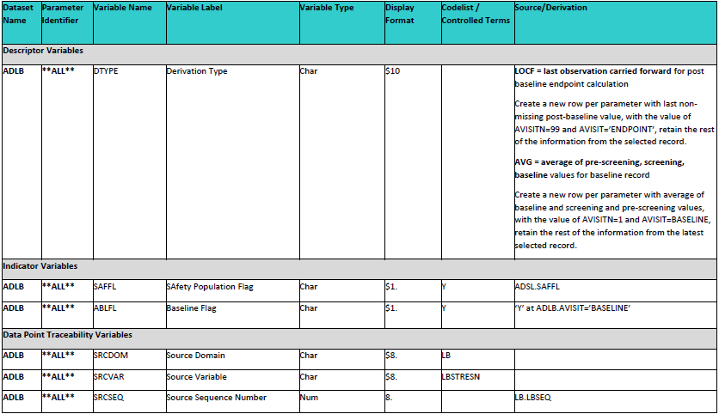
ADLB – BDS Structure
New row created
TCS confidential

Slide 9
ADLB – BDS Data
STUDY | ADDOMAIN | USUBJID | SUBJID | SITEID | TRTA | TRTAN | AVISIT | AVISITN | PARAM | PARAMCD | AVAL | BASE | CHG | DTYPE | SAFFL | ABLFL | SRCDOM | SRCVAR | SRCSEQ
XXXX | ADLB | XXX-001-001 | 1 | 1 | A | 1 | PRE-SCREENING | -10 | CREATININE (mg/L) | CREA | 110 | . | . |  | Y |  | LB | LBSTRESN | LBSEQ
XXXX | ADLB | XXX-001-001 | 1 | 1 | A | 1 | SCREENING | 1 | CREATININE (mg/L) | CREA | 109 | . | . |  | Y |  | LB | LBSTRESN | LBSEQ
XXXX | ADLB | XXX-001-001 | 1 | 1 | A | 1 | BASELINE | 2 | CREATININE (mg/L) | CREA | 110 |  | . |  | Y |  | LB | LBSTRESN | LBSEQ
XXXX | ADLB | XXX-001-001 | 1 | 1 | A | 1 | BASELINE | 2 | CREATININE (mg/L) | CREA | 109.7 | 109.7 | . | AVG | Y | Y | LB | LBSTRESN | LBSEQ
XXXX | ADLB | XXX-001-001 | 1 | 1 | A | 1 | VISIT 3 | 3 | CREATININE (mg/L) | CREA | 114 | 109.7 | 4.3333 |  | Y |  | LB | LBSTRESN | LBSEQ
XXXX | ADLB | XXX-001-001 | 1 | 1 | A | 1 | VISIT 4 | 4 | CREATININE (mg/L) | CREA | 102 | 109.7 | -7.667 |  | Y |  | LB | LBSTRESN | LBSEQ
XXXX | ADLB | XXX-001-001 | 1 | 1 | A | 1 | VISIT 5 | 5 | CREATININE (mg/L) | CREA | 121 | 109.7 | 11.333 |  | Y |  | LB | LBSTRESN | LBSEQ
XXXX | ADLB | XXX-001-001 | 1 | 1 | A | 1 | ENDPOINT | 99 | CREATININE (mg/L) | CREA | 121 | 109.7 | 11.333 | LOCF | Y |  | LB | LBSTRESN | LBSEQ
TCS confidential

Slide 10
Summary of Key BDS parameters
Parameter (PARAM) and Parameter Code (PARAMCD)
PARAM) describes, and must uniquely and sufficiently identify, the contents of the relevant analysis value variable AVAL or AVALC. PARAMCD is the code for PARAM is map one to one
Differences between PARAM and SDTM xxTEST
SDTM xxTEST is designed to work in conjunction with other variables called qualifiers in order to describe the collected result and PARAM is the only variable that describes AVAL or AVALC, qualifiers are not allowed.
Parameter Category (PARCATy)
PARCATy is used to group parameters into categories
Parameter Type (PARAMTYP)
Parameter Type (PARAMTYP) flags "derived" parameters ; often misleading when used with DTYPE and will be retired in the next version
TCS confidential

Slide 11
Summary of Key BDS parameters
Derivation Type (DTYPE)
DTYPE serves two functions: when populated on a given record,
(1) it indicates that the record is derived from other records within the same parameter and
(2) it identifies the algorithm used to derive the analysis value (AVAL or AVALC) on the record
Baseline Type (BASETYPE)
BASETYPE refers to a definition of baseline that characterizes the value of BASE on that row in case of multiple baseline definition
Baseline Record Flag (ABLFL)
Baseline flag ABLFL must be set to "Y" on the row whose analysis value AVAL is used to populate BASE for that parameter and subject
Analysis Visit (AVISIT)
Analysis visit AVISIT is used to describe the analysis visit or conceptual timepoint characterizing the row
TCS confidential

Slide 12
Summary of Key BDS parameters
BDS Population Flags
Subject-Level Population Flags: Subject-level population flags are contained in ADSL, and can be copied to BDS datasets.
e.g.: ITTFL
Record-Level Population Flags: Record-level population flag variable names end in RFL . A record-level flag is useful when there are reasons for excluding some records within subject and parameter from the analysis.
e.g.: PPROTRFL="Y"
Parameter-Level Population Flags: Parameter-level population flag variable names end in PFL. A parameter-level flag is useful when observed data influence whether or not a subject is considered to be in a population for reporting purposes.
e.g.: for the analysis of a given parameter, a subject is included in the analysis if
(1) the subject is a member of the ITT population, and
(2) for the given parameter, the subject has a non-missing baseline value (BASE) and at least one non-missing post-baseline value of AVAL. For the subjects who meet both conditions, the parameter-level Full Analysis Set population flag FASPFL is set to "Y" on all rows for the parameter
TCS confidential
Notes:
E.g. PCSA

Slide 13
ADaM variable rules

Slide 14
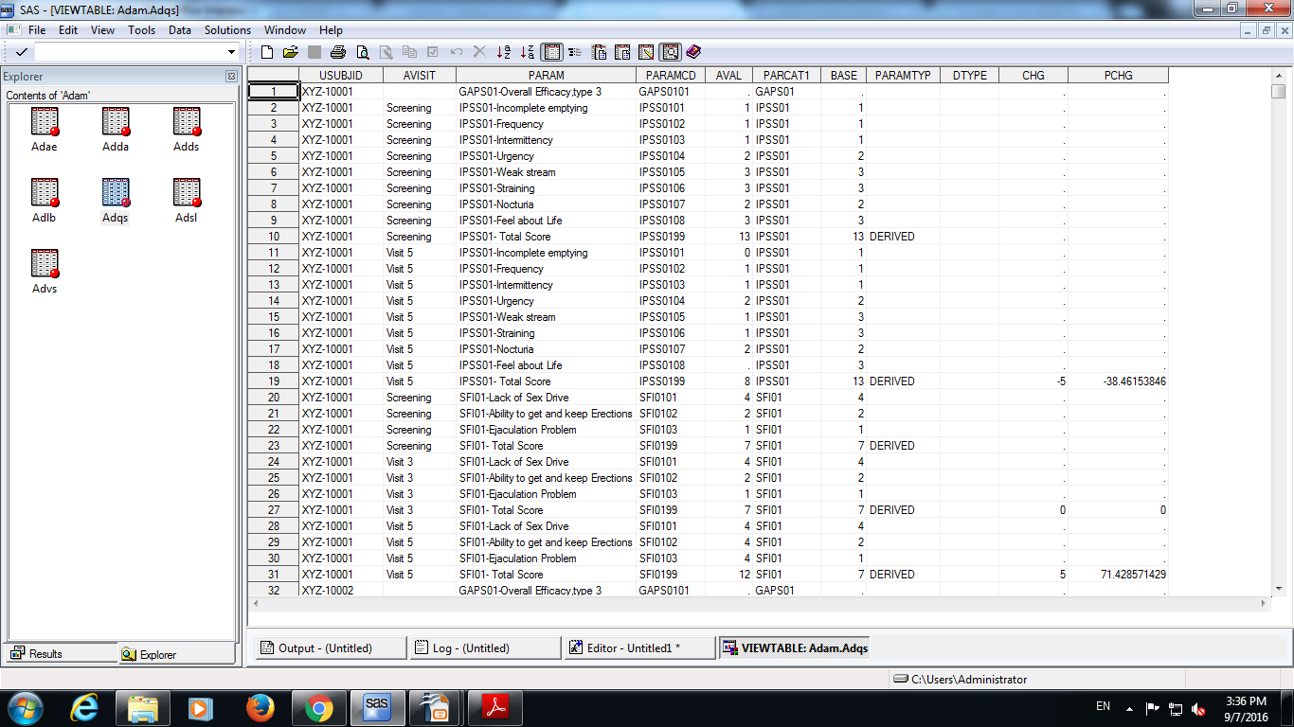
Rules for creation of rows and columns in ADaM
Rule 1 :
A parameter-invariant function of AVAL and BASE on the same row that does not involve a transform of BASE should be added as a new column.
Example of Rule 1: CHG or PCHG as both are derived from AVAL and BASE on the same row and are calculated for all the rows and there is no transformation of BASE.
TCS confidential

Slide 15
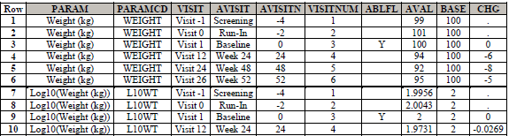
Rules for creation of rows and columns in ADaM
Rule 2 :
A transformation of AVAL that does not meet the conditions of Rule 1 should be added as a new parameter, and AVAL should contain the transformed value
TCS confidential
Notes:
Example of rule 2,3,4,5: The table in the next slide contain a variable PARAM which has the values “SFI01- Total Score” and “IPSS01- Total Score” are the function of more than one row or parameter.

Slide 16
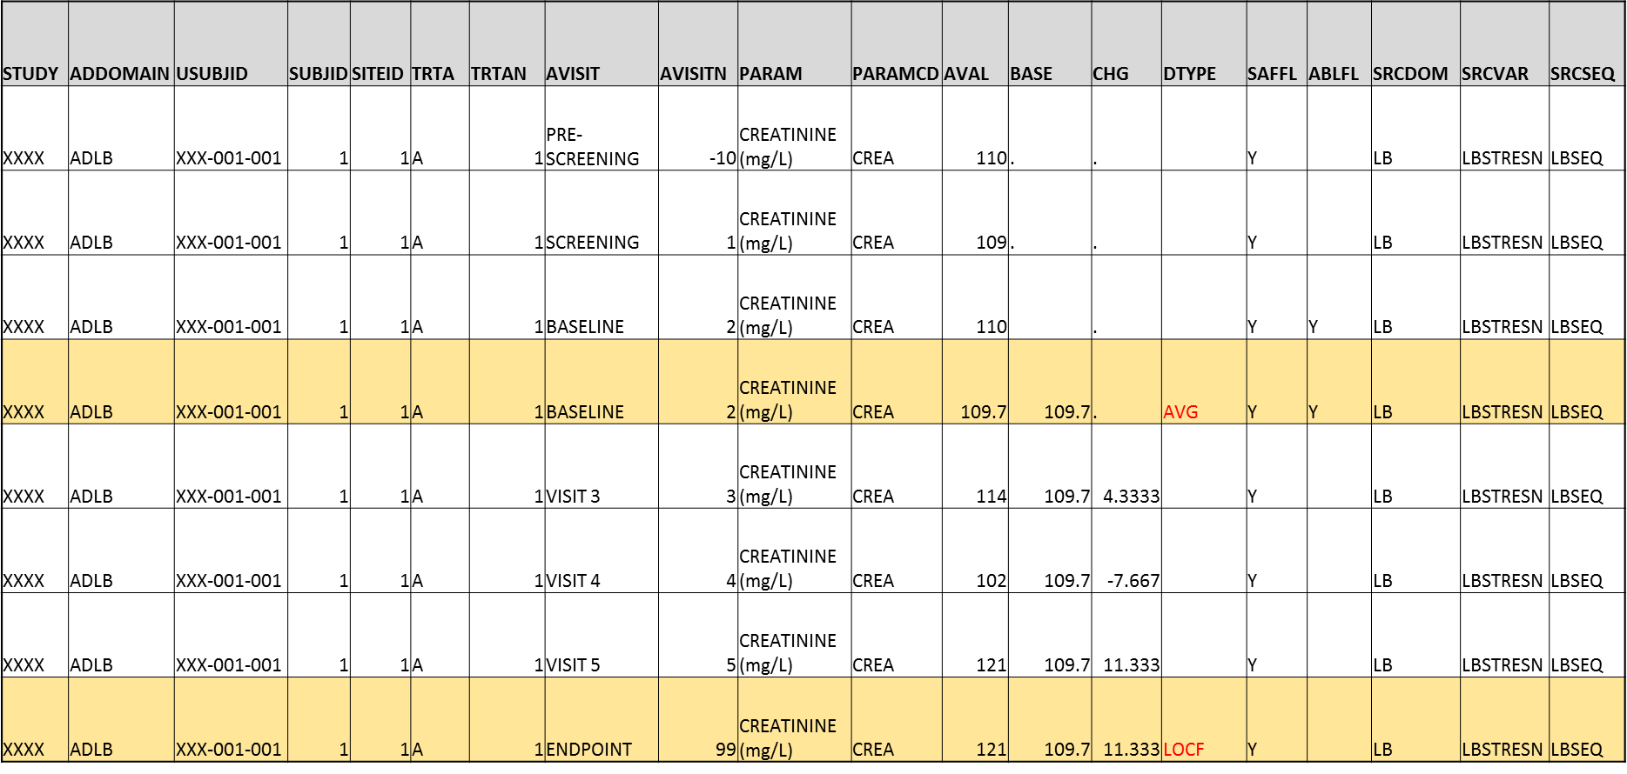
Rules for creation of rows and columns in ADaM
Rule 3 :
A function of one or more rows within the same parameter for the purpose of creating an analysis timepoint should be added as a new row for the same parameter.
TCS confidential
Notes:
Example of rule 2,3,4,5: The table in the next slide contain a variable PARAM which has the values “SFI01- Total Score” and “IPSS01- Total Score” are the function of more than one row or parameter.

Slide 17
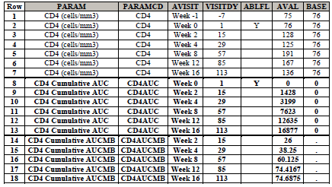
Rules for creation of rows and columns in ADaM
Rule 4 :
A function of multiple rows within a parameter should be added as a new parameter.
Rule 4 is a special case of Rule 2. The functions covered by this rule violate the second condition of Rule 1 (they are not same-row functions of AVAL), and may also violate the first and third conditions.
Let AVAL(t) equal the value of CD4 cell count at post-baseline visit t, and let VISITDY(t) be the planned study day of visit t.
CD4AUC (cumulative daily CD4 count over follow-up) is calculated at any given post-baseline visit as follows:
• CD4AUC at baseline visit is set to 0.
• CD4AUC(t) = CD4AUC(t-1) + [ 0.5 * AVAL(t-1) + 0.5 * AVAL(t) ] * [ VISITDY(t) - VISITDY(t-1) ].
CD4AUCMB (cumulative average change from baseline in daily CD4 count over follow-up) is calculated as
• CD4AUCMB(t) = CD4AUC(t) / [ VISITDY(t) - 1 ] - baseline value of CD4 cell count.
TCS confidential
Notes:
Example of rule 2,3,4,5: The table in the next slide contain a variable PARAM which has the values “SFI01- Total Score” and “IPSS01- Total Score” are the function of more than one row or parameter.

Slide 18
Rules for creation of rows and columns in ADaM
Rule 5 :
A function of more than one parameter should be added as a new parameter
BMI= Weight(kg)/[Height(m)]²
AVISIT | AVISITN | PARAM | PARAMCD | AVAL
BASELINE | 2 | Height (cm | HGT | 157
PRE-SCREENING | -10 | Weight (kg) | WGT | 60
SCREENING | 1 | Weight (kg) | WGT | 61
BASELINE | 2 | Weight (kg) | WGT | 61
VISIT 3 | 3 | Weight (kg) | WGT | 60.8
VISIT 4 | 4 | Weight (kg) | WGT | 60.5
VISIT 5 | 5 | Weight (kg) | WGT | 60
BASELINE | 2 | BMI (kg/m2) | BMI | 24.74745
VISIT 3 | 3 | BMI (kg/m2) | BMI | 24.66632
VISIT 4 | 4 | BMI (kg/m2) | BMI | 24.54461
VISIT 5 | 5 | BMI (kg/m2) | BMI | 24.34176
TCS confidential
Notes:
Example of rule 2,3,4,5: The table in the next slide contain a variable PARAM which has the values “SFI01- Total Score” and “IPSS01- Total Score” are the function of more than one row or parameter.

Slide 19
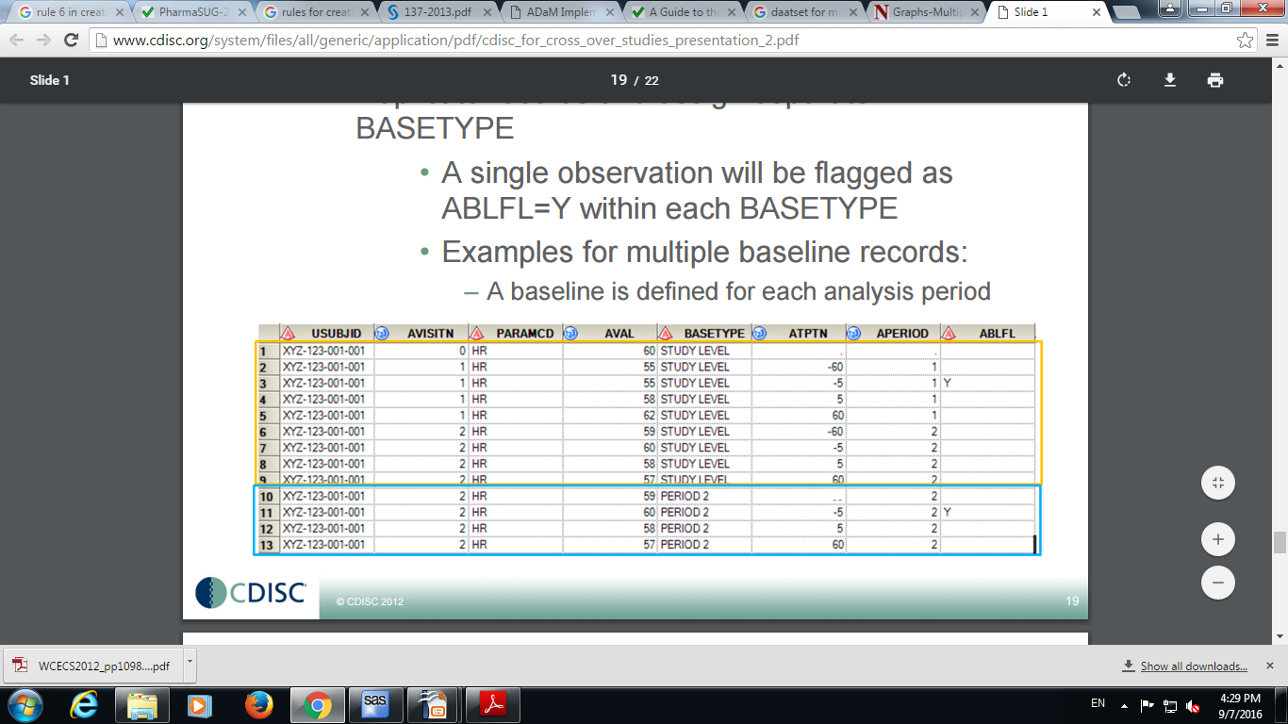
Rules for creation of rows and columns in ADaM
Rule 6 :
When there is more than one definition of baseline, each additional definition of baseline requires the creation of its own set of rows.
TCS confidential

Slide 20
Implementing Baselines in BDS

Slide 21
Baseline and various possibilities
Do we always need create new records for all subjects and all parameters?
When BASETYPE is needed?
How to implement DTYPE accordingly?
Parallel , single phase trial – straight forward implementation
In this case, there is only one baseline per subject per parameter.
Crossover study – not so straight forward implementation
The baseline for a period could be defined as the last non-missing value on or before the first dosing date of each period.
In this case, there is one baseline per subject per parameter per period.
Studies with time-matched definition of baselines
In these cases, there can be one baseline per subject per parameter per visit
In case of Extension trials the baselines could be dependent on the ARM

Slide 22
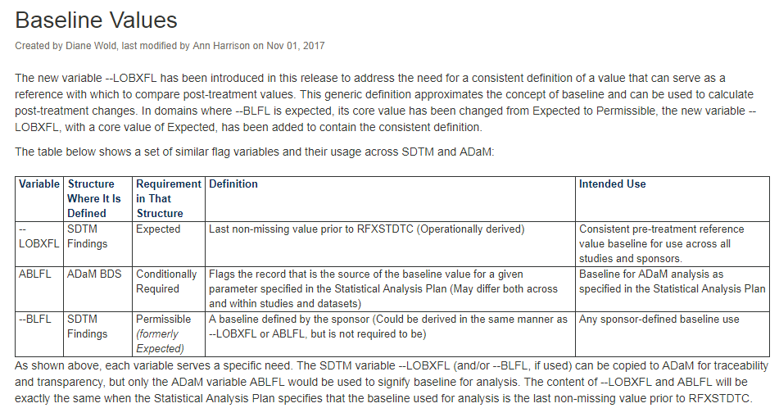
CDISC Baseline Definitions

Slide 23
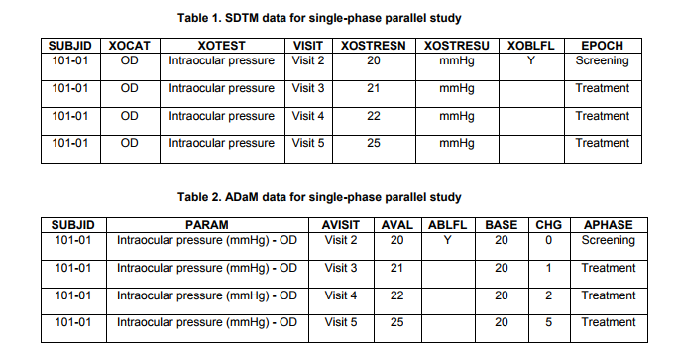
Example 1
Case I: Single-phase parallel study
Baseline is defined as the last non-missing value on or before first dosing date.
Simple implementation
Baseline implementation

Slide 24
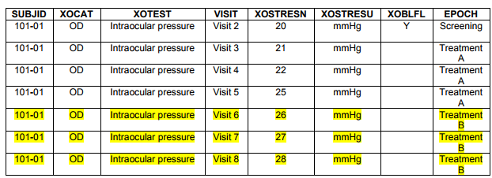
Example 2 – problem
Case I: Two-phase parallel studies
the baseline is defined as the last non-missing value on or before first dosing date of each treatment phase.
Two different baselines per subject per parameter
For subject 101- 01, the intraocular pressure value at Visit 2 (20 mmHg) is the baseline for all records.
In the meantime, the intraocular pressure value at Visit 5 (25 mmHg) is the baseline for all records the second treatment phase (Treatment B, highlighted in yellow).
So for records at Visits 6, 7, and 8, there are two baseline values - one from Visit 2 and the other one from Visit 5.
Notes:
How to implement this? Intuitively, one may think about adding variables, ABLFL2, BASE2, CHG2, PCHG2, etc. Quite a few folks did implemented BDS this way
But this is not ADaM-compliant. According to ADaM IG v1.0 and draft v1.1

Slide 25
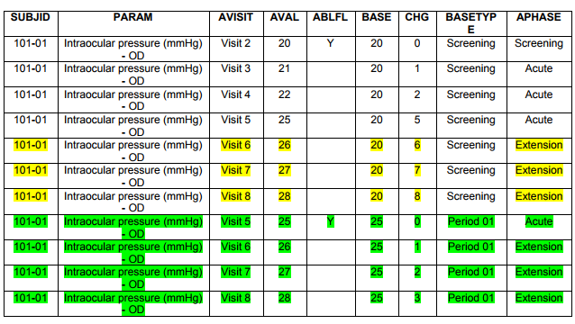
Example 2 – solution approach
Rule 6. When there is more than one definition of baseline, each additional definition of baseline requires the creation of its own set of rows.
One of the possible implementation
There are two sets of records which can be distinguished by BASETYPE.
The first set of records has BASETYPE = 'Screening' and the second set of records has BASETYPE = 'Period 01'.
the second set of records uses the baseline from Period 1 (Visit 5).
BASETYPE is required when there are multiple baselines.
Notes:
How to implement this? Intuitively, one may think about adding variables, ABLFL2, BASE2, CHG2, PCHG2, etc. Quite a few folks did implemented BDS this way
But this is not ADaM-compliant. According to ADaM IG v1.0 and draft v1.1

Slide 26
Example 2 – Summary / Discussion
Whether a subject received two different treatments in the two treatment phases or received the same treatment in two different treatment phases, there are two sets of records.
In the first set of records, the baseline is picked up from the last non-missing value on or before the first dosing date.
In the second set of records, the baseline is picked up from the last non-missing value on or before the first dosing date for the second phase.
Scenario 2:
Baseline for records in the second treatment phase can be dependent on whether a subject took different treatments in two treatment phases.
If a subject took the same drug in both phases, the baseline for both phases are the same.
If a subject took different drugs in the two phases, the baseline for the first phase is from the screening visit and the baseline for the second phase is the last non-missing value before the start of extension phase.
For this analysis, the above implementation is not perfect for table programming.
Notes:
How to implement this? Intuitively, one may think about adding variables, ABLFL2, BASE2, CHG2, PCHG2, etc. Quite a few folks did implemented BDS this way
But this is not ADaM-compliant. According to ADaM IG v1.0 and draft v1.1

Slide 27
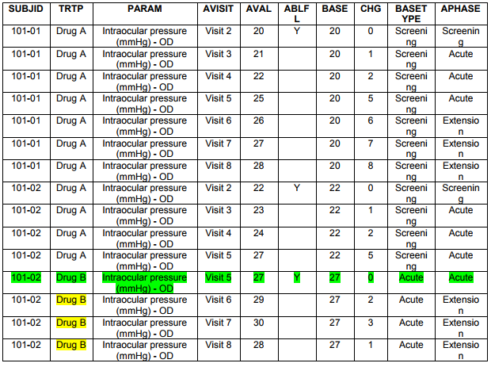
Example 2 – New solution
Modify the above approach as follows:
Subjects who did not change treatment (such as Subject 101-01), just create the first set of records.
For subjects who changed treatment (such as Subject 101-02), use the first baseline for acute phase analysis and use the second baseline for the extension phase analysis.
Notes:
How to implement this? Intuitively, one may think about adding variables, ABLFL2, BASE2, CHG2, PCHG2, etc. Quite a few folks did implemented BDS this way
But this is not ADaM-compliant. According to ADaM IG v1.0 and draft v1.1

Slide 28
Example 2 – New solution Summary / Discussion
For subjects (such as 101-01) who took the same drug in acute and extension phases (TRT01P = TRT02P), there is only one set of records.
For subjects (such as Subject 101-02) who took different drugs (drug switchers) in acute and extension phases, there are still two sets of records that can be distinguished by BASETYPE.
For drug switchers, each set of records has less records than in the previous implementation. Actually, only one new record (the baseline for the second set) has been created per subject per parameter.
Notes:
The newly created record (highlighted in green), Drug B is populated as TRTP, which can facilitate the table programming. 5). One may wonder whether creating only one new record violates Rule 6 in ADaM IG 1.0/1,1. The answer is no. This implementation is ADaM compliant. Rule 6 implies that new records should be created when there is more than one baseline for the same record. In the previous example, the record at VISIT = Visit 5 has two different baselines (and CHG), but no other records have multiple baselines. So only a duplicate record of VISIT = Visit 5 is created. In general, if a subject has different baselines for different records, there is no need to create any extra records. New records need be created only when there are two or more baseline values for the same record.

Slide 29
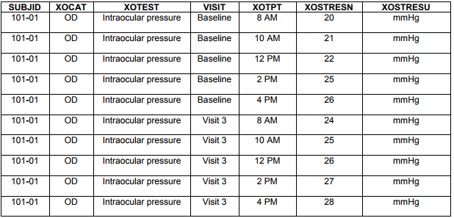
Example 3
Case III: Time matched
Especially in Phase I studies, some parameters are measured in a series of time points at each of scheduled visits.
The baselines could be defined as the value at each time point at the baseline visit. So there is a baseline per subject per parameter per time point.
Notes:
In this case, there will be a baseline for each of the following time points: 8 am, 10 am, 12 pm, 2 pm, and 4 pm. But there is only one baseline for each record. Value at 8 am at VISIT = Baseline will be and will only be used as the baseline for all 8-am records. Similarly, 10-am value at VISIT = Baseline will be and will only be used as the baseline for 10-am records. No new records are to be created. Consider all these, one can implement ADaM data as shown in Table 7. In this example, there are five different baselines per subject per parameter, no extra records have been created.

Slide 30
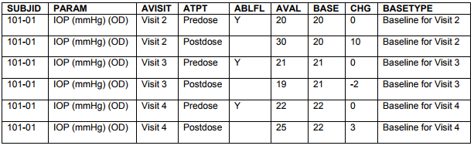
Example 4
Case IV: By visit baseline
In study where pre-dose and post-dose measurements need to be analyzed.
Ophthalmology studies the difference of pre-dose and post-dose measurements such as intraocular pressures (IOP) need be analyzed
BASETYPE is needed since more than one record within one PARAM is flagged by ABLFL.
According to ADaM IG V1.0, if there are multiple baseline records flagged for a given parameter within a subject then BASETYPE should be populated and contain different values for the baseline records within a subject.
Notes:
Please note that BASETYPE cannot be simply set as "By-visit Baseline".

Slide 31
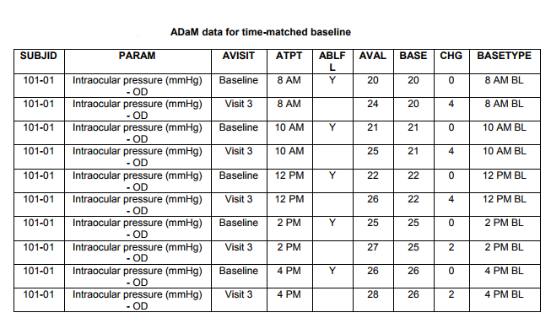
Example
Case V: Combination of time matched and By visit baseline

Slide 32
Conclusion for creation of baseline
When there is more than one baseline, one cannot add new variables such as BASE2 and CHG2.
When there is more than one definition of baseline, each additional definition of baseline requires the creation of a set of its own rows. The identification of which row is the baseline involves comparison of more than one row,
When there is more than one baseline definition per subject per parameter, one does not always need create new rows for the same record.
For time-matched baseline and by-visit baseline, no new records are created.
DTYPE need be appropriately implemented when new records are created. ADaM has controlled terminology for DTYPE. The current existing CT terms include LOCF, WOCF, AVERAGE etc.
There is no controlled terms for the baseline records.
BASETYPE is needed whenever there is more than one baseline (ie, more than one record with ABLFL = Y) per subject per parameter.
Notes:
ADaM IG explains this clearly. In ADaM IG, there are 6 rules, among which the following two are related: Rule 1. a parameter-invariant function of AVAL and BASE on the same row that does not involve a transformation of BASE should be added as a new column. The derivation of the second baseline involves scanning all pre-treatment record and thus it cannot be added as a new column. Similarly, change from second baseline also involved more than one record and cannot be added a new column, either
Rule 6 is the direct inference of Rule 1.
Rule 6 implies that when there are two definitions of baselines, there must be two rows of the same record. However, this rule does not explain what means by "more than one baseline". The actual meaning of this rule is "When there is more than one baseline definition for the same record (or AVAL), each additional definition of baseline requires the creation of a set of its own rows. This implies that no matter how many baseline definitions there are for a parameter, if there is only one baseline definition for a single record, no new rows need be created.
Neither ADaM IG v1.0 nor ADaM IG v1.1 has addressed this. However, CDISC ADaM team is working on this issue and more controlled terminologies will be added.
Having multiple BASETYPE does not imply creation of new sets of records. For instance, for the case of time-matched baseline, there are multiple values of BASETYPE, but no new records have been created. 5) Creating new records makes development and validation of ADaM datasets much harder. It is wise to avoid adding any new records if possible.

Slide 33
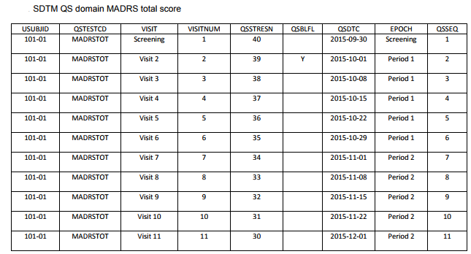
Adding new BDS variables for a cross-over study
The example below is from a CNS study and assume that the efficacy measurement MADRS total scores is in SDTM QS data
The first subject has measurements at screening visit and all eight visits in two treatment periods. In addition, this subject took drug A 100 mg daily dose from 2015-10-01 until 2015-10-28 and then took Drug B 200 mg daily dose from 2015-11-01 to 2015-11-29.
Notes:
Montgomery–Åsberg Depression Rating Scale

Slide 34
Adding new BDS variables for a cross-over study
ADaM dataset for the efficacy measurement ADMADRS can be implemented as below.
Compared to SDTM data, three new records are added –
Two endpoint records (one for each period, highlighted in green)
One baseline record for Period 02 (highlighted in yellow).
Variables APERIOD and APERIODC are introduced.
For records with AP01SDT <= ADT <= AP01EDT or the baseline record for the first treatment period, APERIODC = Period 1.
For records with AP02SDT <= ADT <= AP02EDT and the records for the second treatment period, APERIODC = Period 2.
For other records such as the measurement at the screening visit, APERIODC is set to blank. Note that ADaM IG states that APEROD/APERIODC are associated with TRTxxP.
For the screening visit, there is no treatment associated, and thus, APERIOD and APERIODC are set to missing.
Notes:
Montgomery–Åsberg Depression Rating Scale

Slide 35
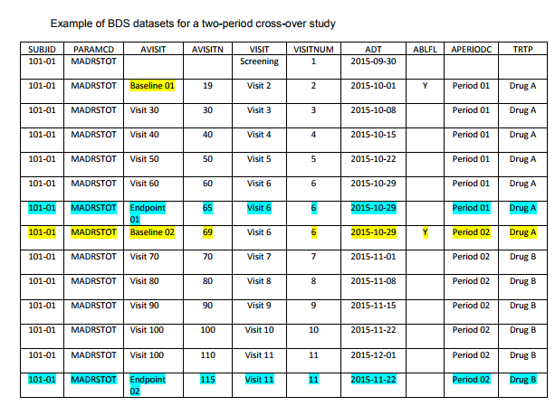
Adding new BDS variables for a cross-over study
APERIOD is set to 1 for the added baseline record (ADT = 2015-10-01 and AVISITN = 19) for Period 01. This record is from pre-treatment period and is before AP01SDT (2015-10-01).
Similarly, APERIOD is set to 2 for the added baseline record (ADT = 2015-10-29 and AVISITN = 69) for Period 02, even though ADT for this record is before the start date of Period 02 (AP02SDT = 2015-11-01).
This implementation can facilitate table programming
Notes:
Montgomery–Åsberg Depression Rating Scale

Slide 36
Adding new BDS variables for a cross-over study
TRTP = Drug A for records with APRIOD = 1, and
TRTP = Drug B for records with APERIOD = 2.
Two baseline records are both flagged using variable ABLFL = Y.
For the analysis of the last record in each period, a new record with DTYPE = Endpoint is added for each period.
The record with AVISITN = 65 is the last-record for Period 01.
The record with AVISITN = 115 is added for Period 02.
Notes:
TRTP is the planned treatment associated with the AVAL on date ADT. In this implementation, TRTA and TRTP for the baseline records are set to TRTA and TRTP, respectively in the associated periods. It noteworthy that TRTP and TRTA are record-level variables, which means that in a BDS dataset, TRTP and TRTA can be different from record to record. In contrast, variables TRTxxA and TRTxxA are subject-level variable and should be invariant of records. APERSDT and APEREDT are also record-level variables. For instance, APERSDT = 2015-10-01 and 2015-11-01 for records in Period 01 and Period 02, respectively.
Please note that there is only one baseline flag variable (ABLFL) allowed in a BDS dataset no matter how many different baselines there are per subject per parameter. Similarly, there is only one change from baseline variable (CHG) allowed. There is only one baseline value variable (BASE) allowed.
The last records cannot be identified by adding variables. In ADaM IG V1.1 or V1.0, there are 6 rules that decide whether a row or a column should be added. Rule 3 states that function of one or more rows within the same parameter for the purpose of creating an analysis timepoint should be added as a new row for the same parameter.

Slide 37
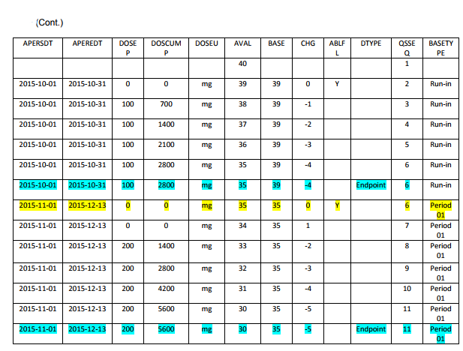
Adding new BDS variables for a cross-over study
For the analysis of the last record in each period, a new record with DTYPE = Endpoint is added for each period.
The record with AVISITN = 65 is the last-record for Period 01.
The record with AVISITN = 115 is added for Period 02.
Notes:
TRTP is the planned treatment associated with the AVAL on date ADT. In this implementation, TRTA and TRTP for the baseline records are set to TRTA and TRTP, respectively in the associated periods. It noteworthy that TRTP and TRTA are record-level variables, which means that in a BDS dataset, TRTP and TRTA can be different from record to record. In contrast, variables TRTxxA and TRTxxA are subject-level variable and should be invariant of records. APERSDT and APEREDT are also record-level variables. For instance, APERSDT = 2015-10-01 and 2015-11-01 for records in Period 01 and Period 02, respectively.
Please note that there is only one baseline flag variable (ABLFL) allowed in a BDS dataset no matter how many different baselines there are per subject per parameter. Similarly, there is only one change from baseline variable (CHG) allowed. There is only one baseline value variable (BASE) allowed.
The last records cannot be identified by adding variables. In ADaM IG V1.1 or V1.0, there are 6 rules that decide whether a row or a column should be added. Rule 3 states that function of one or more rows within the same parameter for the purpose of creating an analysis timepoint should be added as a new row for the same parameter.

Slide 38
References
Reference
Reference
Reference
Reference
Reference
Reference
Notes:
Content Slide- 2 row / comparison

Slide 39
Thank You
For any feedback/comment/clarification please contact us at PALS@tcs.com
V NN

Slide 40
Document Release Notice
This XXXXXXX, Version NN, is released for use in Tata Consultancy Services (TCS) with effect from – DD-Mmm-YYYY.
This Training Material is subject to TCS Document Control Procedure. TCS reserves the right to make additions, modifications or alterations to the existing content or release a newer version of this document.
Softcopy of the latest version of the document is available in the ABCDEFG
Comments suggestions or queries should be addressed to PALS@tcs.com.
Date: DD-Mmm-YYYY
Date: DD-Mmm-YYYY
Document Name
Effective Date: DD-MMM-YYYY
V NN
Notes:
Font size 9pt

Slide 41
Change/Revision History
Version No. | Revision Description | Slide No. | Rationale for the Change | Change type (Add/Modify/Delete) | Modified By | Date Modified (DD-Mmm-YYYY)
V NN

